Slide 1
Decreasing and Increasing by a Percentage

Slide 2
Decrease in Price
Common words:
Reduction
Discount
Sale
Loss
Depreciation

Slide 3
Increase in Price
Common words
Mark-up
Profit
Inflation

Slide 4
Topic: Inflation EQ: How does inflation effect the price of items?
Inflation is a measure of how the cost of living is changing.
The yearly percentage increase is called the annual inflation rate and is usually accompanied by an increase in workers’ wages and salaries “to keep up with inflation”.
If workers’ wages and salaries increase is below the inflation rate then the wage is not “keeping up with inflation.

Slide 5
Topic: Discount, Commission and Profit and Loss EQ: How do I tell if it is a percentage increase or decrease?
GST:
10% Goods and Service Tax that is added to cost price of many items.
It is a 10% mark-up.
Means it is 110% of amount before GST
Discount:
Is a mark-down
It’s the amount taken off the original price.
It is a percentage decrease question.
Pg 32

Slide 6
Topic: Discount, Commission and Profit and Loss EQ: How do I tell if it is a percentage increase or decrease?
Commission:
Is the fee charged by some businesses for selling an item.
Sometimes based on the sale price achieved.
Eg. Car salesman, real estate agents.
Commissions are often the percentage of the value of sales
Pg 33

Slide 7
Topic: Discount, Commission and Profit and Loss EQ: How do I tell if it is a percentage increase or decrease?
Profit and Loss:
Profit is made when the goods are sold for more than the cost price.
A loss is made when the goods are sold for less than the cost price.
Pg 33-34

Slide 8
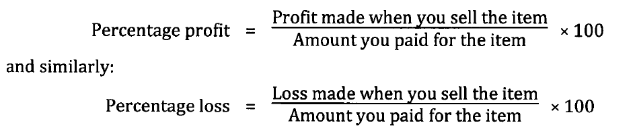
Topic: Discount, Commission and Profit and Loss EQ: How do I tell if it is a percentage increase or decrease?
Pg 34

